Slide 1
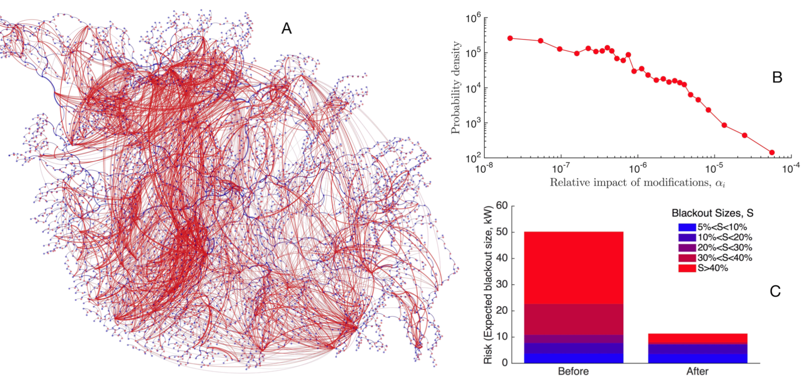
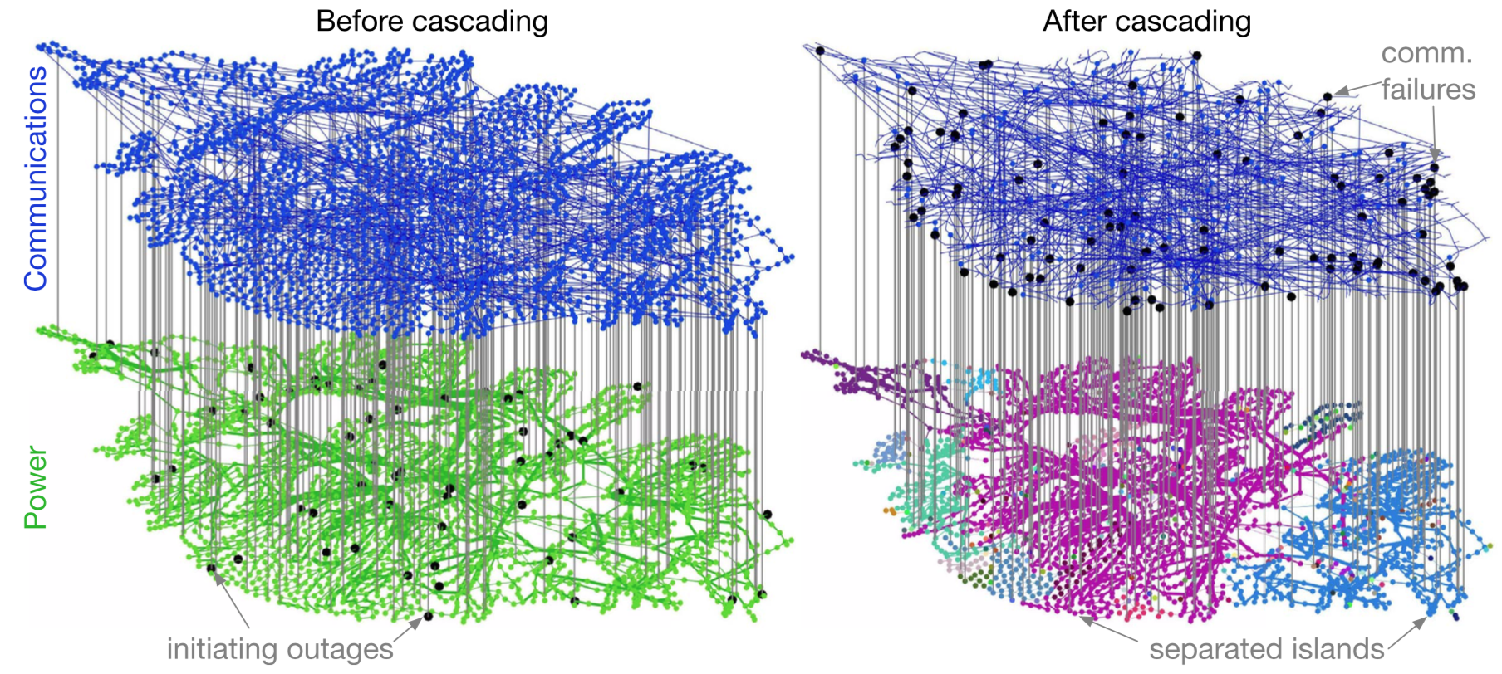
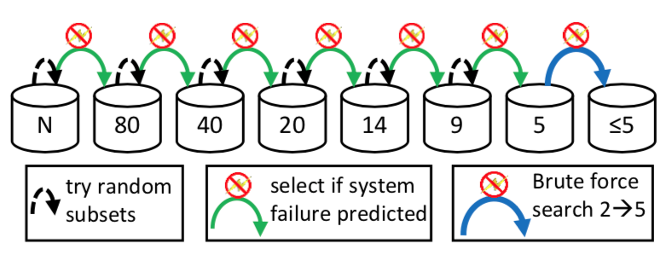
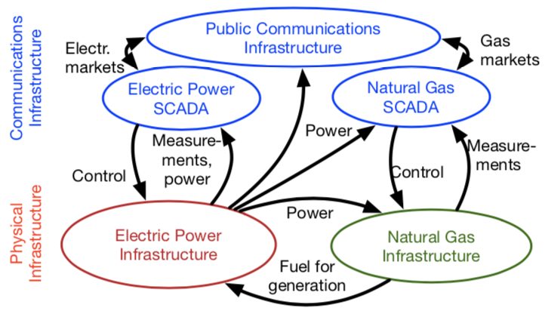
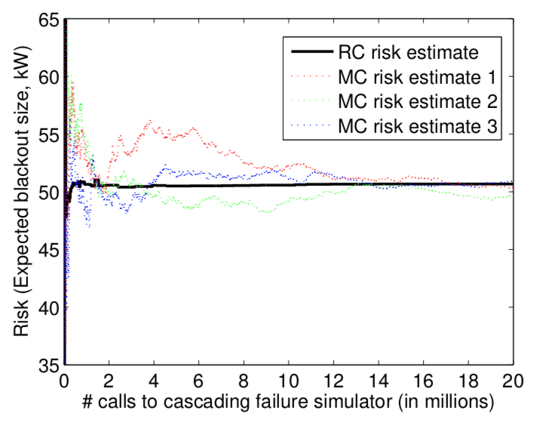
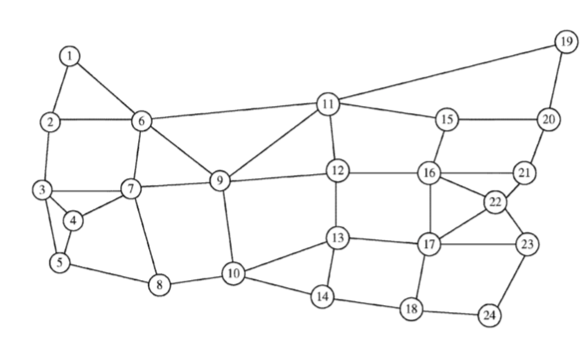
CRISP Type 2/Collaborative Research Understanding the Benefits and Mitigating the Risks of Interdependence in Critical Infrastructure Systems
Ian Dobson (ISU), Margaret Eppstein (UVM), Amy Glasmeir (MIT), Paul Hines (PI, UVM), Eytan Modiano (MIT), Konstantin Turitsyn (MIT)
Themes
Computational methods
Organizational dynamics
Interconnections among infrastructures can be beneficial. E.g., additional communication links create new ways to optimize performance.
Interconnections can also introduce new mechanisms of cascading failure. E.g., reliance on degraded communication networks can slow restoration after power grid failures.
What are the conditions under which the benefits of interdependence outweigh risks?
What resources enhance resilience? Which ones detract from it?
Describing how intersectoral perceptions of risk affect organizational dynamics that encourage or inhibit the cooperation and coordination to increase resilience.
Interdependence modeling
Coupling power system, natural gas and communication system models
Influence graphs reveal patterns of cascading that can be used to mitigate risks.
Test Case
Probabilistic Shared Risk Link Groups help identify correlated link failures
The random chemistry algorithm can quickly measure risk and find critical elements
Combining cascading failure and restoration modeling

